Slide 1
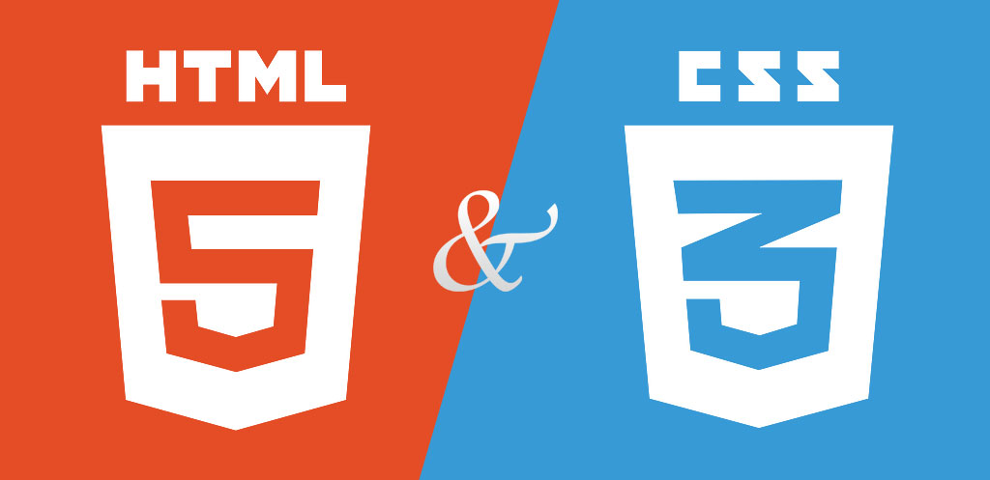
Web Design & Development

Slide 2
Course outcomes
Learn about web design, through theory and exercises
Code a basic website using HTML5 and CSS3 using Sublime Text 2
Plan a basic web site
Check and validate your webpages
Research web hosting and domain name options
What’s next

Slide 3
Web Design & Development
day 1
What is HTML
Tools needed to create a website
Create a good folder structure
Structure of HTML: head and body
Styling your Website (Cascading Style Sheets, aka: css)

Slide 4
HTML5 (cont.)
day 1
Title tags and meta tags
Body tags
Comments
Headings / Paragraphs / Breaks
Horizontal rulers
Lists (ordered and unordered)
Block elements v/s inline elements
Insert images
Connect your pages with hyperlinks
HTML5 semantic tags

Slide 5
Cascading Style Sheet 3 (CSS3)
day 2
Inline, Embedded, External CSS
Classes & Id’s
Selectors and attributes
Fonts and web safe fonts
Why style the different parts of the site
Colours / Graphics / images formats
Inserting graphics into HTML
Adding background images
Hyperlinks (internal/external)
Units of measure (1px, 1em, 1%, 1fr)
Notes:
affecting of specific selectors/objects - ie: “.class > tag: (further options such as nth-child(odd))”
Using fractions (fr) as a measurement is useful when laying out a page using CSS Grid

Slide 6
Controlling the Layout
day 3
Floats
CSS3 Grid
Flex-Box
Plan Your own Website
Notes:
Watch podcast “CSS Grid Layout Crash Course.mp4”

Slide 7
Building your own Web Project
day 4
Put what you’ve leant into practice

Slide 8
Build your own Web Project (cont.)
day 5
Proofreading / Spellchecking
No pixilation on images
Online code checking
Feedback from others
Final error correction

Slide 9
Wrapping up…
day 6
Sum up and make a glossary
Look at alternatives to web authoring software (WIX, dream weaver etc.)
Research web hosting and domain name options
Where to next?

